Slide 1



CAPSTONE PROJECT PRESENTATION
INTELLIGENT MEDICAL DIAGNOSIS AND DRUG RECOMMENDATION SYSTEM
GROUP A

Slide 2


AGENDA
01
02
03
04
Project Overview
Dataset
Workflow
Components of the System
05
06
07
08
Models
LLM Integration
Test Cases
Deployment

Slide 3

MOTIVATION
Why Automated Disease Prediction and Drug Recommendation?
1. Inconsistencies in Manual Diagnosis:
Human Error: Studies indicate that diagnostic errors affect approximately 5% of adults in outpatient settings, leading to significant adverse outcomes (National Academies of Sciences, Engineering, and Medicine, 2015).
Time Constraints: Healthcare professionals often face time pressures, which can lead to rushed consultations and potential oversight of critical symptoms (Zwaan et al., 2010).
Cognitive Biases: Physicians may be influenced by cognitive biases, such as anchoring or availability heuristics, impacting the accuracy of diagnoses (Graber et al., 2005).
2. Advantages of Automation:
Consistency: Automated systems provide consistent diagnostic and treatment recommendations based on vast datasets and established medical guidelines.
Efficiency: AI-driven models can quickly analyze patient data and provide recommendations, reducing wait times and improving patient throughput (Topol, 2019).
Comprehensive Analysis: Machine learning models can identify patterns and correlations in data that may be missed by human clinicians, leading to more accurate diagnoses and personalized treatment plans (Beam & Kohane, 2018).

Slide 4


PROJECT OVERVIEW
Objective:
Develop an integrated AI application that assists in the diagnosis and treatment of patients through natural language processing and machine learning techniques.
Key Components:
Symptom Extraction Model:
Utilizes keyword detection and Named Entity Recognition (NER) to extract symptoms from patient descriptions.
Disease Prediction Model:
Employs machine learning algorithms to predict possible diseases based on extracted symptoms.
Drug Recommendation :
Leverages a comprehensive dataset to suggest appropriate medications for predicted diseases.
Large Language Model Integration:
Incorporates a pre-trained LLM (Mistral Large Latest) to facilitate natural conversations with users, simulating a healthcare professional's dialogue.
Pipeline Integration:
Combines all models into a seamless workflow for automated symptom extraction, disease prediction, and medication recommendation.

Slide 5

DATASET OVERVIEW
Dataset Processing
Disease Prediction Datasets:
Dataset 1: We renamed column names, removed inconsistencies, and converted all column names to lowercase, leveraging the existing one-hot encoding.
Dataset 2: We:
Lowered column names
Filtered rows with a positive outcome variable
Renamed column names
Converted "yes" values to 1 and "no" values to 0
Drug Recommendation Datasets:
Dataset 1: We selected only the "drug_name" and "medical_condition" columns.
Dataset 2: We renamed columns to match the first dataset:
"Medicine Name" to "drug_name"
"Uses" to "medical_condition"
Dataset 3: We renamed columns to match the first dataset:
"drugName" to "drug_name"
"condition" to "medical_condition"
Final Step: We concatenated the preprocessed drug recommendation datasets into a single dataset.
2
DATASETS FOR DISEASE PREDICTION
"Disease Prediction Using Machine Learning" (Kaggle) - 5000 records.
"Disease-Symptoms and Patient Profile Dataset" (Kaggle) - 350 records
3
DATASETS FOR DRUG RECOMMENDATION
"Drugs, Side Effects, and Medical Conditions" (Kaggle) - 3000 records
"Medicine Dataset" (Hugging Face) - 11800 records
UCI ML Drug Review dataset - 161200 records

Slide 6

WORKFLOW
User Interaction:
The application converses with users to gather symptom information.
Symptom Detection:
Extracts symptoms from user input using NLP models.
Disease Prediction:
Predicts possible diseases based on extracted symptoms.
Medication Suggestion:
Recommends appropriate drugs and treatments for the predicted diseases.
Response Handling:
Provides feedback and manages user inputs, ensuring coherent and relevant conversations.

Slide 7
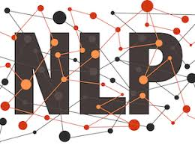
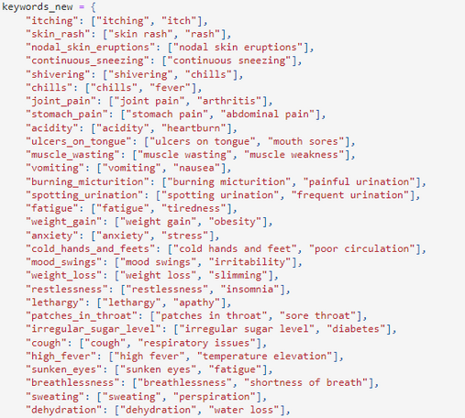
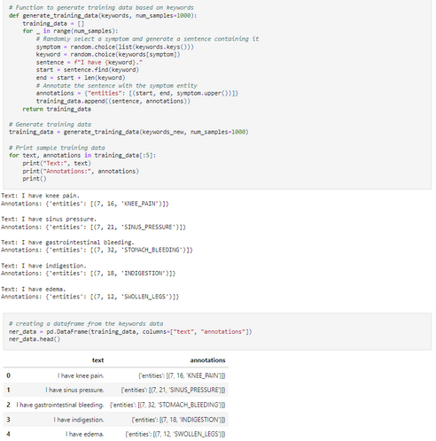
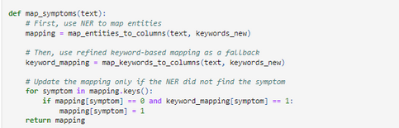
SYMPTOM EXTRACTION
Now when we had the disease prediction dataset ready, we wanted to develop an algorithm which can detect symptoms from a user’s health statement or from natural conversation from an user. For this, we created a dictionary where the keys were the column names of the disease prediction dataset and values were the other synonyms of the symptoms.
It looked like this :
The logic used a combination of Named Entity Recognition model and keyword scan approach using regular expression.
The NER model was trained on an annotated dataset which was built from the keywords_new dictionary data. The purpose of the NER model was to detect the symptoms and map those symptoms to the key symptoms.
Along with the NER model, we used a manual logic as well to detect the symptoms from a user’s statement.

Slide 8
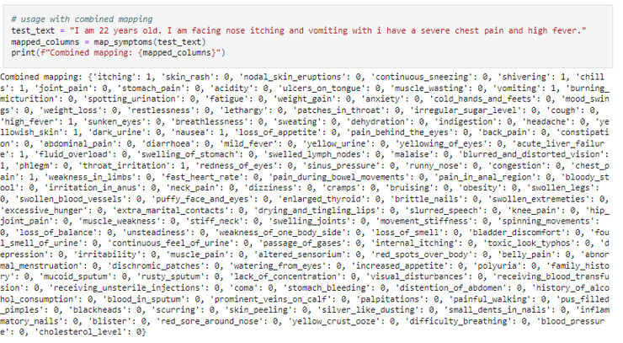
SYMPTOM DETECTION
We wanted to try whether this function can extract symptoms and map it into a one hot encoded dataset which will be given to the disease prediction model in the real application.
As we can see above, the function can detect symptoms and it creates a dataset according to the column or symptom names in our disease prediction model. This is helpful because we can push this data to the model and get the disease name.

Slide 9

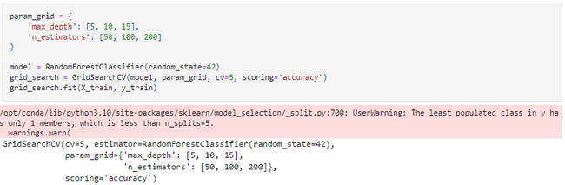
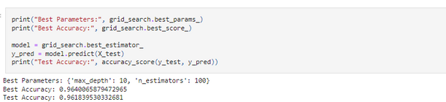
DISEASE PREDICTION MODEL
The target column was ‘prognosis’ which was the disease name column. We first label encoded that column and built out model using Random Forest Classifier using hyperparameter tuning.
We have used Random Forest Classifier for this use case because :
Handling High-Dimensional Data: Random Forest can handle a large number of features (134 symptoms) without feature selection or dimensionality reduction.
Non-Linear Relationships: Random Forest can capture non-linear relationships between symptoms and diseases.
Robust to Outliers: Random Forest is robust to outliers and noisy data.
Handling Imbalanced Data: Random Forest can handle imbalanced datasets, where some diseases may have a larger number of cases than others.
High Accuracy: Random Forest often achieves high accuracy in classification tasks, especially with a large number of trees.
Reducing Overfitting: Random Forest's ensemble approach reduces overfitting, which is common in decision tree models.
We got a nice accuracy score for our disease prediction model. Since we already have good prediction score, we didn’t experiment with more models. We trained the model with 5 fold cross validation and we have used ‘accuracy’ as our metric.
Now it was time to test our initial pipeline which takes a user text, pushes it to the symptom extraction logic and push the output of symptom extraction to the disease prediction model

Slide 10
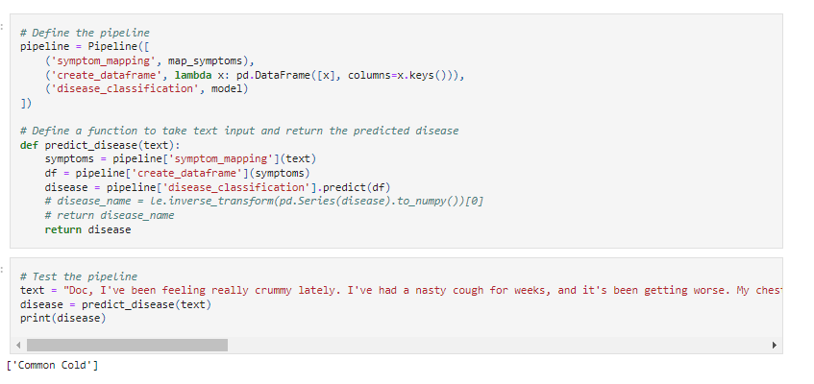
PIPELINE FOR SYMPTOM TO DISEASE PREDICTION
As we can see that our pipeline can take a user / patient statement and can directly return the disease name.

Slide 11
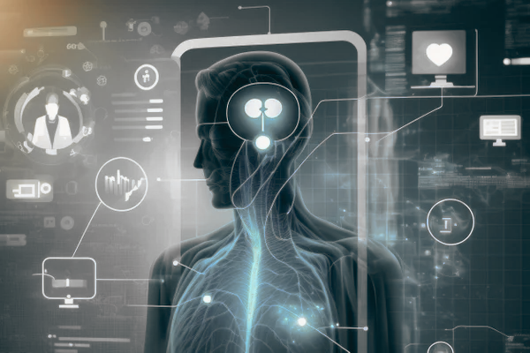
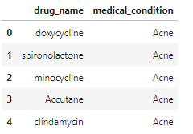
DRUG RECOMMENDATION
For drug recommendation, our application uses the data that we had gathered from 3 different sources. After the disease is predicted, our application searches for the drugs from that dataset with the predicted disease. The drugs dataframe has two columns which look like the following.
This aggregated dataset has a total of 176053 rows.

Slide 12
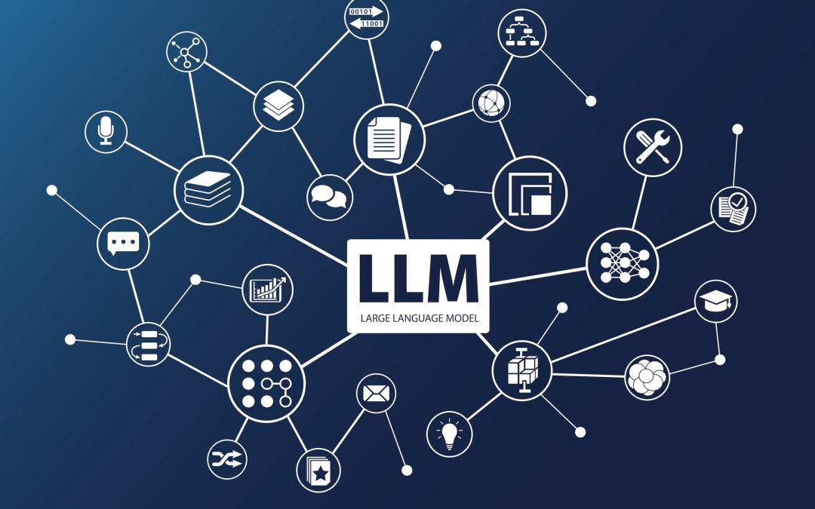

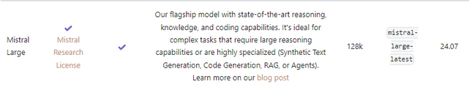

LLM INTEGRATION
Since we are building an interactive chatbot, we used a Large Language Model to continue the operation to ask questions to the user like a healthcare professional does.
Our objective for this application was that it would ask the user about the symptoms like a doctor. Natural way of running the conversation was the primary objective to use a LLM for this application.
The users responses are later combined together and sent to the pipeline for symptom detection and disease prediction model.
The output of that pipeline was returned to the chat application along with the drug recommendations.
How we have made it work
Prompt Engineering
Chatbot Logic
Integration with the main function

Slide 13

TEST CASES
Test Case 1: Medical Suggestions by the Chatbot
Result: The issue was resolved through prompt engineering and logic adjustments. The chatbot now only provides information in response to user queries.
Issue Identified: Autonomous medical suggestions.
Resolution: Prompt engineering and logic refinement.
Test Case 2: Intermittent User Input Handling
Result: The system now prompts users continuously for additional symptoms, ensuring comprehensive data collection.
Issue Identified: Discontinuous user interaction.
Resolution: Enhanced LLM prompts and function call adjustments.
Test Case 3: Automated Self-Questioning and Answering
Result: The system no longer asks and answers questions on its own, relying entirely on user inputs.
Issue Identified: Asked questions to itself and answers.
Resolution: Logic revision in the chatbot and main function.
Test Case 4: Symptom Submission to Disease Prediction Pipeline
Result: The introduction of the 'no more symptoms' prompt effectively signals the transition to disease prediction.
Issue Identified: Did not returned disease prediction , only receiving inputs.
Resolution: Implementation of the 'no more symptoms' prompt.
Test Case 5: Handling Gibberish Inputs
Result: The system correctly identifies and handles nonsensical inputs, prompting users for valid information.
Issue Identified: Inappropriate responses to gibberish inputs.
Resolution: Refined prompt engineering to detect and handle invalid inputs.

Slide 14
RATIONALE
Ensuring Controlled Responses: By preventing the chatbot from giving unsolicited medical advice, we ensured that users received accurate and contextually appropriate information, maintaining the integrity of the interaction.
Maintaining Continuous Dialogue: Ensuring continuous user interaction was crucial for gathering comprehensive symptom data, thereby improving the accuracy of disease predictions.
Preventing Automated Interactions: By fixing automated self-questioning, we ensured that the system relied solely on user inputs, thereby increasing the reliability of the diagnosis.
Efficient Data Collection and Processing: Establishing a clear signal ('no more symptoms') for when to process collected data ensured that the system effectively transitioned from data collection to disease prediction.
Handling Invalid Inputs: By addressing gibberish inputs, we ensured that the system could handle unexpected user behavior gracefully, maintaining a high level of user experience and interaction quality.

Slide 15
TEST CASES
Coverage of Different Scenarios
Edge Cases:
Autonomous medical suggestions by the chatbot.
Automated self-questioning and answering.
Handling gibberish or nonsensical user inputs.
Typical Use Cases:
Continuous and comprehensive user interaction for symptom collection.
Clear signaling for transitioning to disease prediction.
Accurate and contextually appropriate responses to user queries.
The comprehensive testing approach validated the system's performance and highlighted areas for refinement, ultimately leading to a more reliable and user-centric application.

Slide 16

CONCLUSION
Integration of NLP and Machine Learning Models: Successfully combined multiple models into a seamless pipeline that automates the process from symptom extraction to disease prediction and medication recommendation.
User-Friendly Conversational Interface: Developed an intuitive chatbot interface that mimics a healthcare professional's dialogue, enhancing user interaction and engagement.
Robust Data Handling: Employed comprehensive datasets for model training, ensuring high accuracy and reliability in disease prediction and drug recommendation.
Effective Prompt Engineering: Addressed various edge cases and ensured the chatbot's responses were contextually appropriate and accurate, even in scenarios involving nonsensical user inputs.

Slide 17
CONCLUSION
Recommendations for Future Work or Areas for Improvement
Expand Dataset Diversity: Incorporate more diverse datasets to improve model generalization and ensure accuracy across a broader range of diseases and symptoms.
Improve User Interaction Handling: Enhance the chatbot's ability to handle more complex and nuanced conversations, potentially integrating more advanced dialogue management techniques.
Refine Symptom Extraction: Further refine the Symptom Extraction Model to capture more subtle and complex symptom descriptions, potentially using more sophisticated NLP techniques such as deep learning-based models.
Integrate Real-Time Updates: Enable real-time updates to the medical and drug databases to ensure the system provides the most current and relevant recommendations.

Slide 18

Deployment

